Slide 1

CS-5800 THEORY FOUNDATION PROJECT PRESENTATION
SCIENTIFIC CALCULATOR USING
LEX AND YACC
PRESENTED BY
UTKARSHA P KOTKAR
SAI RAM UNGARALA

Slide 2
Problem Description
Construction of a scientific calculator with some arithmetic, trigonometric and conversion functions embedded in it.
Implementation using two powerful tools capable of processing expressions
Lex and YACC
(Yet Another Compiler Compiler)
Lex tool provides a table of regular expressions and corresponding program fragments. It is a program generator designed for lexical processing of character input streams
Grammars for YACC are described using a variant of Backus Naur Form. A BNF grammar is used to express context-free languages.
Our calculator takes input in form of an expression and produces necessary output if expression is correct and an error in case of incorrect input.

Slide 3
Approach to the problem
Using Lex and YACC to build a calculator requires an understanding of how they perform and the phases involved in the compilation process.
Decision is to be made about the sections of the lex and how a token is to be considered.
Next Lex and YACC are combined to generate a C code for the analyzer and parser.
YACC error handling is done by a token called error. This can be used in grammar rules to identify and recover in case of error occurs
The error token is a special feature of YACC that will match all input until found and yyerror() is called.
Finally user can continue entering input until they want to further perform any operation or exit with ctrl+c

Slide 4
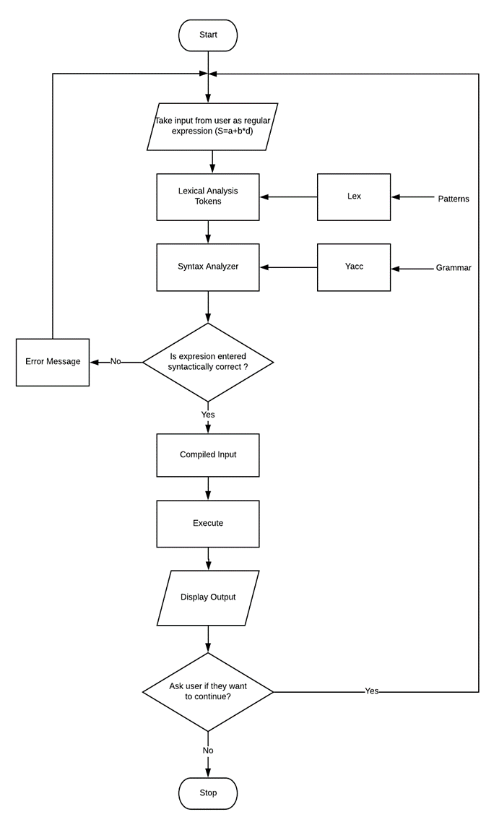
Design of Approach

Slide 5
Implementation Overview
Lex generates programs to be used in simple lexical analysis of text.
The input file contain regular expressions to be searched for and actions written in C to be executed when expression are found.
A C source program lex.yy.c is generated.
This Lex can be used with a parser generator (YACC) to perform lexical analysis phase.
Lex is used to partition the input stream and parse generator assigns structure to the resulting pieces.

Slide 6
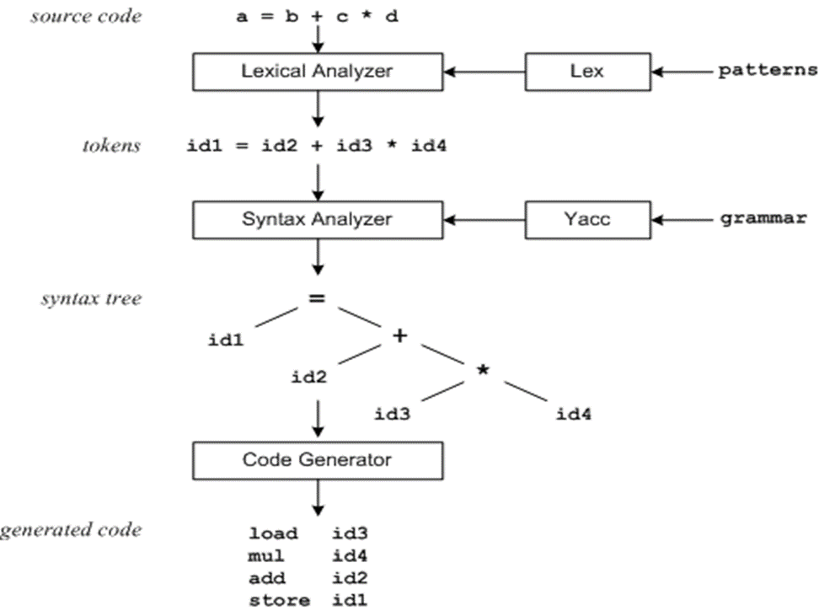
Compilation sequence

Slide 7
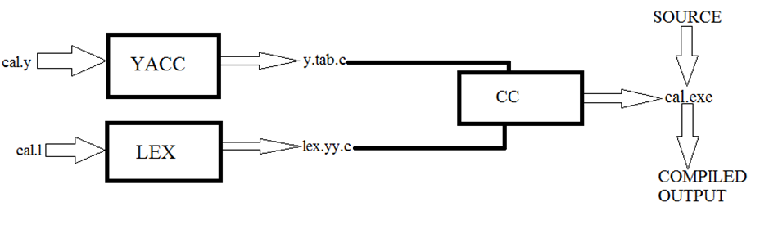
Implementation Overview

Slide 8
Test Cases and Samples
Arithmetic operations(+,-,/,*,^)
Expressions((a+b*c)/d)
Conversion(Fahrenheit to Celsius, currency conversions, meters to kilometers and vice versa)
Trigonometric functions(sin, cos, tan)hyperbolic functions(sinh,cosh,tanh)
Others(absolute value, ceil,floor value, logarithmic and modulo, factorial, Square root.)

Slide 9
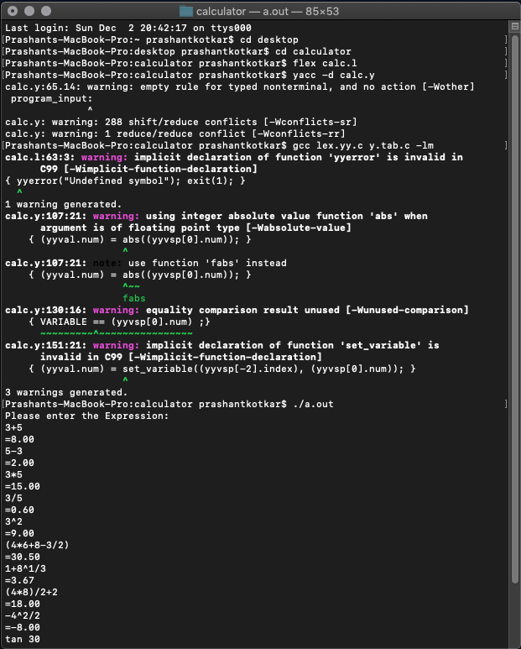
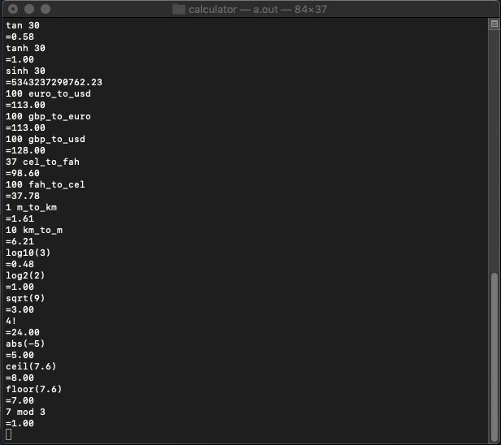
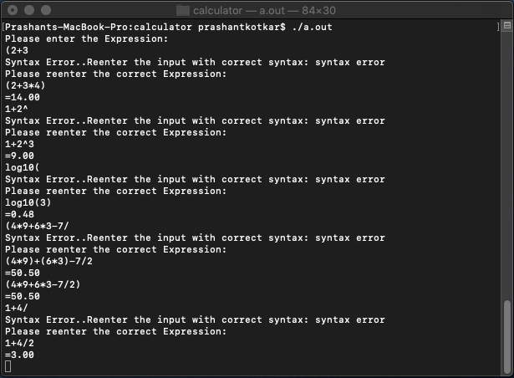
Screenshots of Test Cases
Basic Arithmetic
Operations and Expressions
Trigonometric functions and others
Error handling and recovery

Slide 10
Result and discussions
Our Calculator produces the Expected Results for Basic Arithmetic operations, Expressions, Conversions, Trigonometric Functions, Logarithmic Functions and Others.
Error handling works fine when an user enters a incorrect input not matching the syntax or undefined symbol is given.
Error Message is displayed and user is prompted to re-enter the correct expression.

Slide 11
Execution Steps
Launch the command prompt and navigate to the target project folder.
Write the command
flex calc.l to compile the lex file.
Write the Yacc command yacc -d calc.y to compile yacc file and generate y.tab.c.
Compile the lex.yy.c and y.tab.c using compiler to generate an executable file a.exe by writing command gcc lex.yy.c y.tab.c –lm.
Run the a.exe file using ./a.out command.
Calculator is ready to perform operations with existing functions.
If user writes wrong input not matching with syntax or other than existing functions, then it will throw error message.
Press Ctrl+c to exit the calculator

Slide 12
References
The Lex & Yacc Page. (n.d.). Retrieved from http://dinosaur.compilertools.net/
Write text parsers with yacc and lex. (2006, May 31). Retrieved from https://www.ibm.com/developerworks/aix/tutorials/au-lexyacc/index.html
TutorialsPoint. (n.d.). Implementation by LEX Program. Retrieved from https://www.tutorialspoint.com/compiler_design/implementation_by_lex_program.asp

